Slide 1

SREETHIGAA S 715521104044 PSG Institute of Technology and Applied Research
Final Project
03/04/2024 Annual Review

Slide 2

Deep Learnning based- Fashion item classification
Deep Learning-Based Fashion Item Classification: Predicting Clothing Types using Fashion-MNIST dataset
03/04/2024 Annual Review

Slide 3


AGENDA
Problem Statement
Project Overview
End Users
Solution and Value Proposition
Unique Aspects of the Solution
Modelling
Results
03/04/2024 Annual Review

Slide 4

PROBLEM STATEMENT
Develop a classification model for the Fashion-MNIST dataset, consisting of 70,000 grayscale images categorized into 10 different fashion items. The objective is to build a model capable of accurately classifying each image into one of the following categories:
T-shirt/top
Trouser
Pullover
Dress
Coat
6.Sandal
7.Shirt
8.Sneaker
9.Bag
10.Ankle boot
03/04/2024 Annual Review

Slide 5

PROJECT OVERVIEW
This project aims to develop a classification model for the Fashion-MNIST dataset, consisting of 70,000 grayscale images categorized into 10 different fashion items. Through a collaborative Jupyter notebook, contributors will explore data preparation, model creation, and evaluation processes, fostering experimentation with various algorithms and preprocessing techniques. By leveraging visualizations and explanations, the notebook serves as a community-driven resource for building and testing classification models, encouraging contributions, and knowledge-sharing to enhance model performance and understanding.
03/04/2024 Annual Review

Slide 6

WHO ARE THE END USERS?
Machine Learning Practitioners: Professionals and enthusiasts in the field of machine learning who seek to explore, experiment, and improve classification models using the Fashion-MNIST dataset. They utilize the collaborative notebook as a practical resource for learning, testing new techniques, and benchmarking their approaches.
Researchers: Academics and researchers studying image classification, deep learning, or fashion-related topics. They leverage the project's collaborative nature and comprehensive documentation to gain insights, replicate experiments, and contribute to the advancement of classification methodologies.
Students: Individuals studying machine learning, computer vision, or related disciplines who utilize the project as an educational tool to understand data preprocessing, model building, and evaluation techniques. The interactive nature of the notebook fosters hands-on learning and experimentation.
03/04/2024 Annual Review

Slide 7

SOLUTION AND ITS VALUE PROPOSITION
Utilizing TensorFlow/Keras, design an architecture featuring a discriminator network and a generator.
Craft a neural network comprising multiple layers of activation functions and fully connected layers.
Adjust layer sizes, network depth, and normalization techniques.
Develop a neural network with a binary classification output that shares architectural decisions with the generator.
03/04/2024 Annual Review

Slide 8

THE WOW IN SOLUTION
Dynamic Community Collaboration: The emphasis on collaboration and contributions from a diverse community of machine learning practitioners and enthusiasts adds a "wow" factor to the solution. This dynamic and inclusive environment fosters a rich exchange of ideas, insights, and improvements, creating a vibrant ecosystem for learning and experimentation.
Real-world Relevance and Application: The focus on the Fashion-MNIST dataset and its relevance to industries such as retail, fashion, and e-commerce adds another "wow" factor to the solution. By addressing a practical and domain-specific problem, the project offers tangible value and applicability, demonstrating the power of machine learning in addressing real-world challenges and driving innovation in various sectors.
03/04/2024 Annual Review
8

Slide 9

MODELLING
Data Preparation: Before modeling, the Fashion-MNIST dataset is loaded and preprocessed. This includes tasks such as normalization, reshaping, and splitting the dataset into training and testing sets.
Model Selection: Multiple machine learning models are considered, including deep learning models and traditional machine learning classifiers Each model's architecture, complexity, and suitability for the task are assessed.
Model Architecture: For deep learning models, the architecture is designed, comprising multiple layers such as convolutional, pooling, dropout, and fully connected layers. Hyperparameters such as layer sizes, activation functions, and optimization algorithms are selected based on experimentation and best practices.
Training: The selected models are trained on the training dataset using techniques such as backpropagation and gradient descent. During training, model parameters are adjusted iteratively to minimize the loss function and improve performance on the training data.
Evaluation: After training, the models are evaluated using the testing dataset to assess their performance and generalization ability. Evaluation metrics such as accuracy, precision, recall, F1-score, and confusion matrix are computed to measure the models' effectiveness in classifying fashion items.
03/04/2024 Annual Review
9

Slide 10
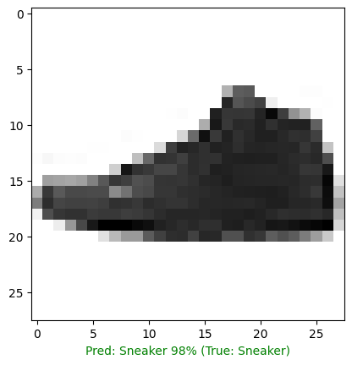
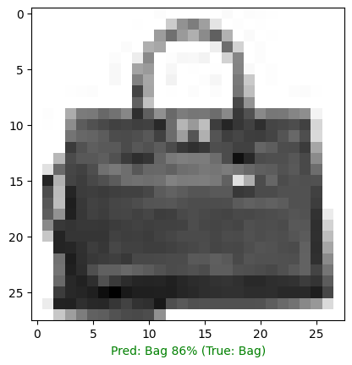
RESULTS
03/04/2024 Annual Review
10

Slide 11
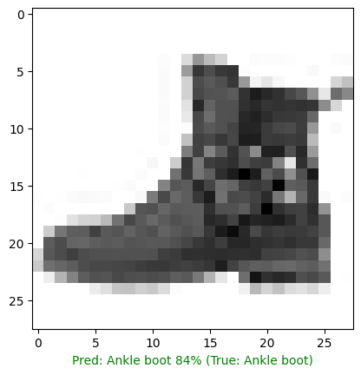
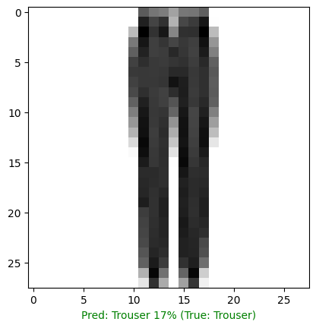
RESULTS
03/04/2024 Annual Review
11

Slide 12
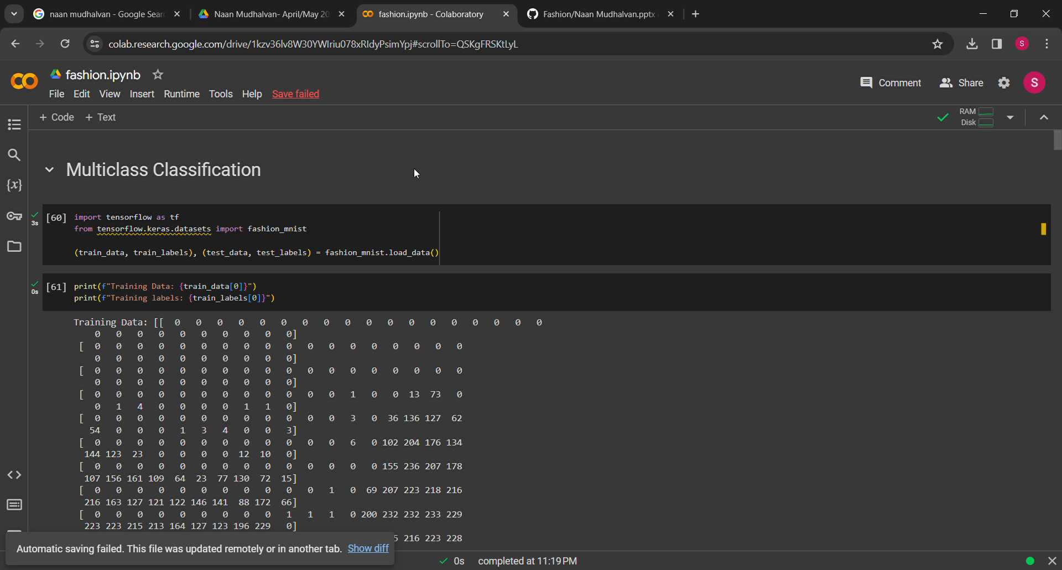

Slide 13
CONCLUSION
In conclusion, our Deep Learning Network has demonstrated significant advancements in recognizing realistic fashion items resembling those in the Fashion-MNIST dataset. The comprehensive documentation facilitates straightforward deployment and accessibility, paving the way for broader applications in image recognition and beyond.
03/04/2024 Annual Review
13

Slide 14
REFERENCES
https://www.tensorflow.org/
https://keras.io/
https://numpy.org/
https://matplotlib.org/
https://www.tensorflow.org/datasets/catalog/fashion_mnist
03/04/2024 Annual Review
14

